Slide 1

Chatap
A simple chat app
Ali Nehme
Gregory Barré
Alina Gotcherian
Notes:
Thank you for watching our demo! We’re going to dive deeper into this projected created by…..
aptly called, chatap.

Slide 2

Create channels around topics. Chat with others in real time.
A simple way to chat with friends around topics
Complex UIs can contribute to visual clutter and hinder accessibility
Extra bells and whistles? Who the hell needs ‘em?
Notes:
We didn’t reinvent the wheel. We drew heavily on existing apps like Discord and Slack, but wanted to create something simpler without all the bells and whistles --
Partly because we’re new to this and wouldn’t have time to do something more complicated.
Unlike Slack, which is often used in workplaces, we saw Chatap as a more casual app just for fun,
and unlike Discord, which has a lot of extra features around customizing channels, video, and voice calls, Chatap is a simpler place where you can simply create and join channels, and chat in real time with strangers and friends
The focus isn’t one-on-one communication or any professional features

Slide 3
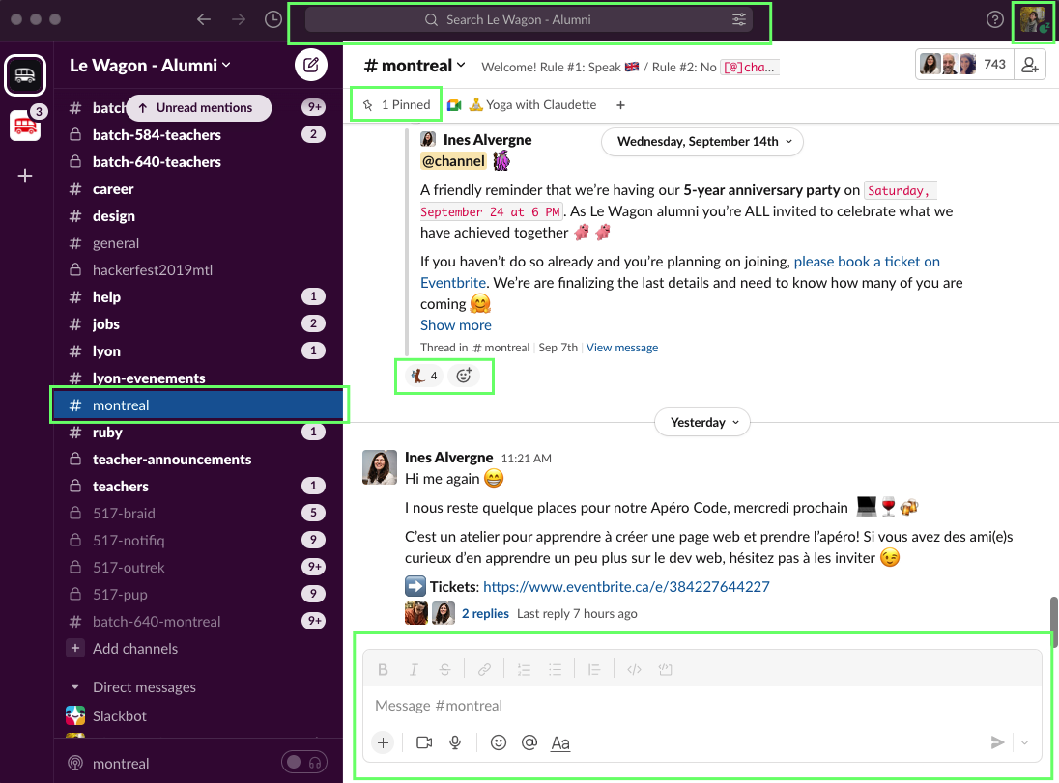
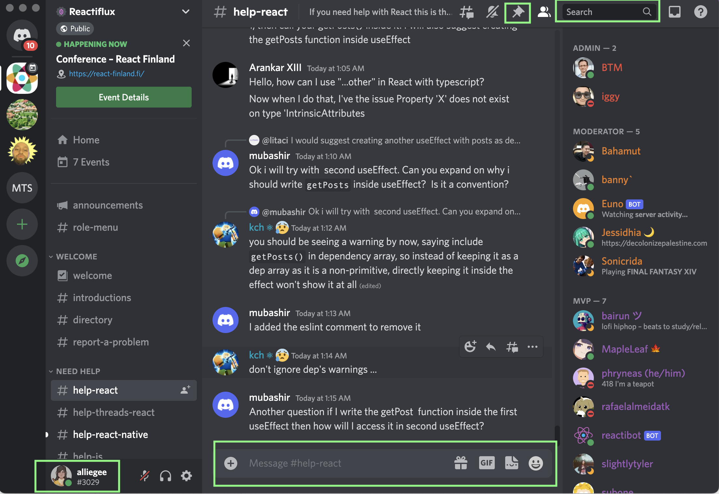
Inspiration
Notes:
So that was our inspiration for the actual chat app, but before we can start chatting, we need to cover registration and login with Ali!

Slide 4
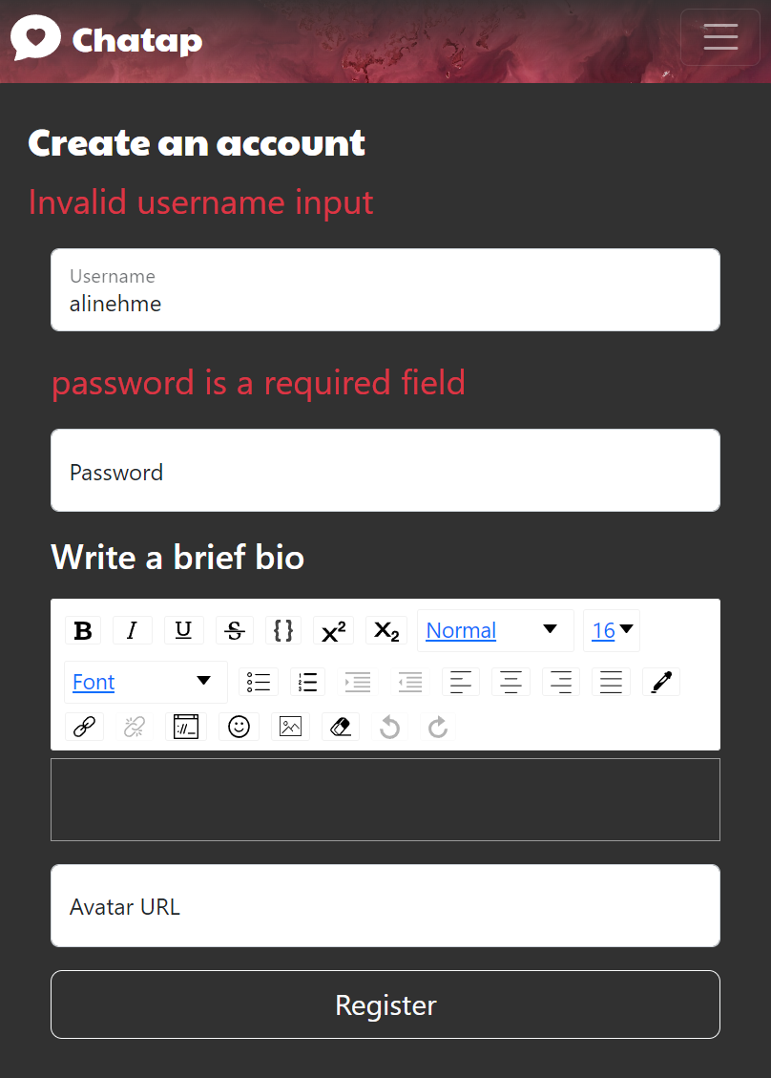
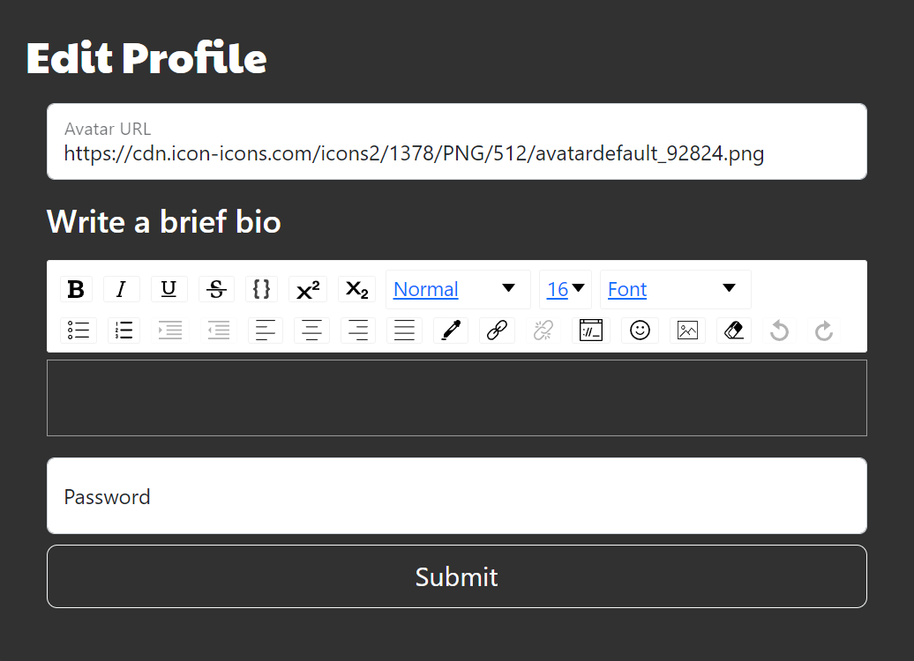
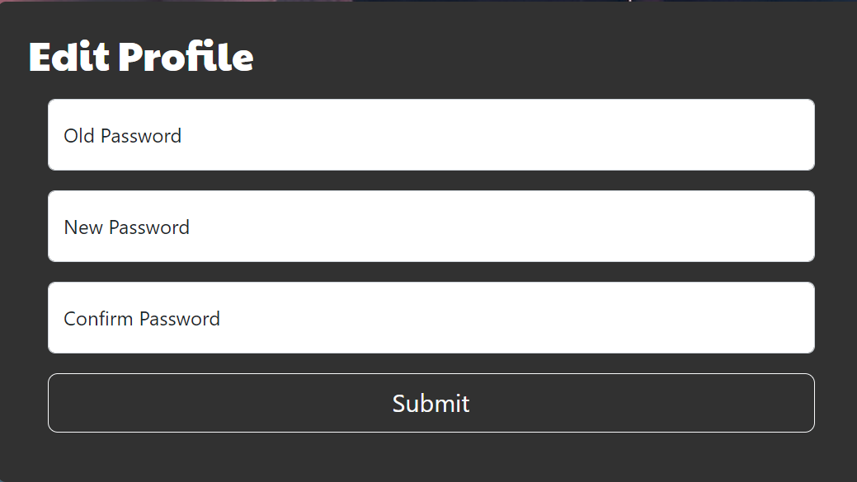
Registration & Profile
Frontend & backend validation
Frontend: Confirm password
Backend: valid old password
Backend: Password validation

Slide 5
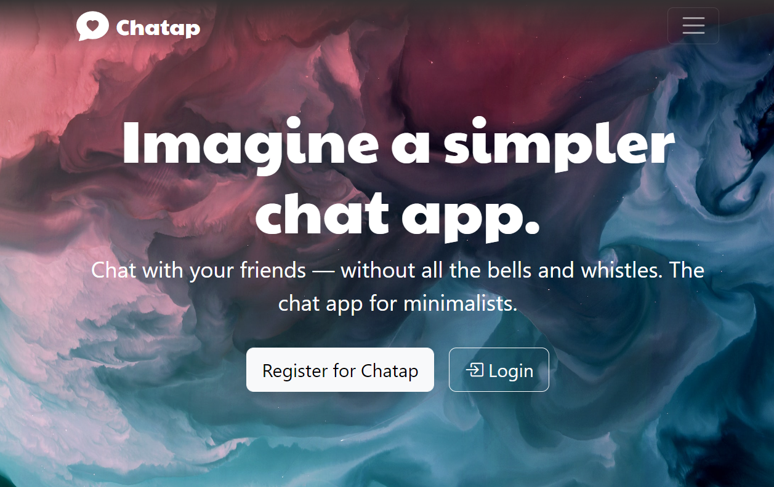
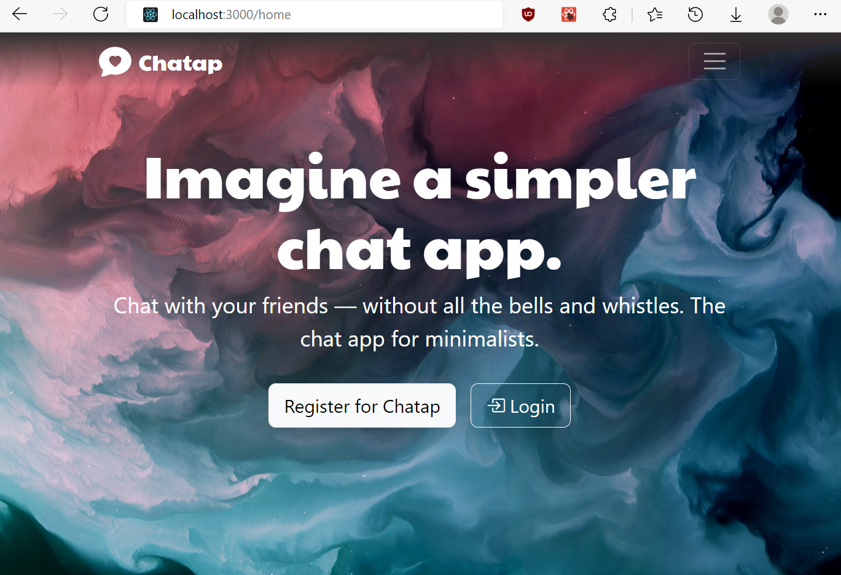
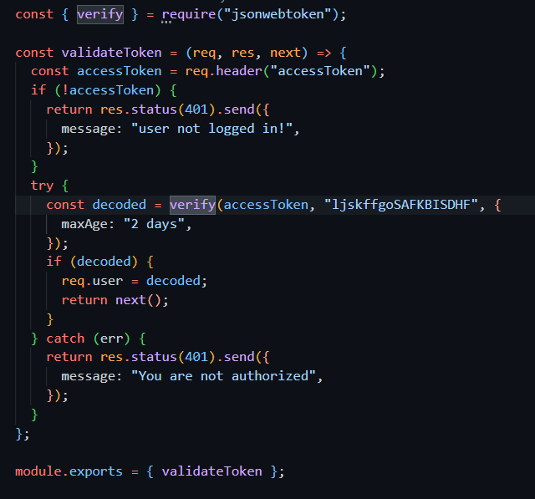
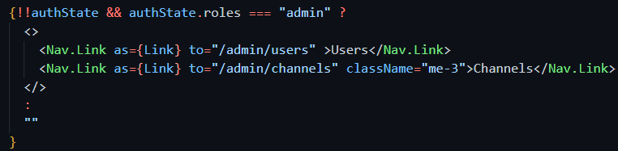
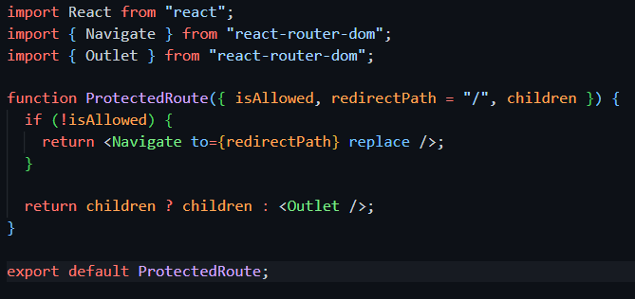
Authorization
Frontend: links
Frontend: Protected Routes
Backend: JWT token
Except login and registration, all actions require backend authorization by JWT

Slide 6
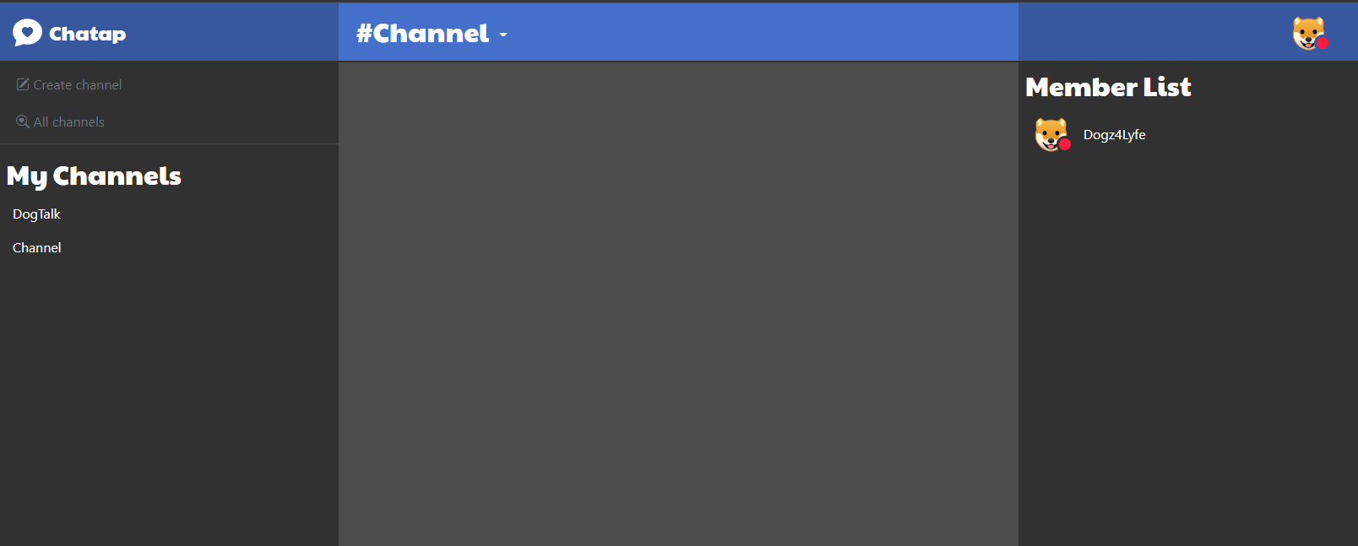
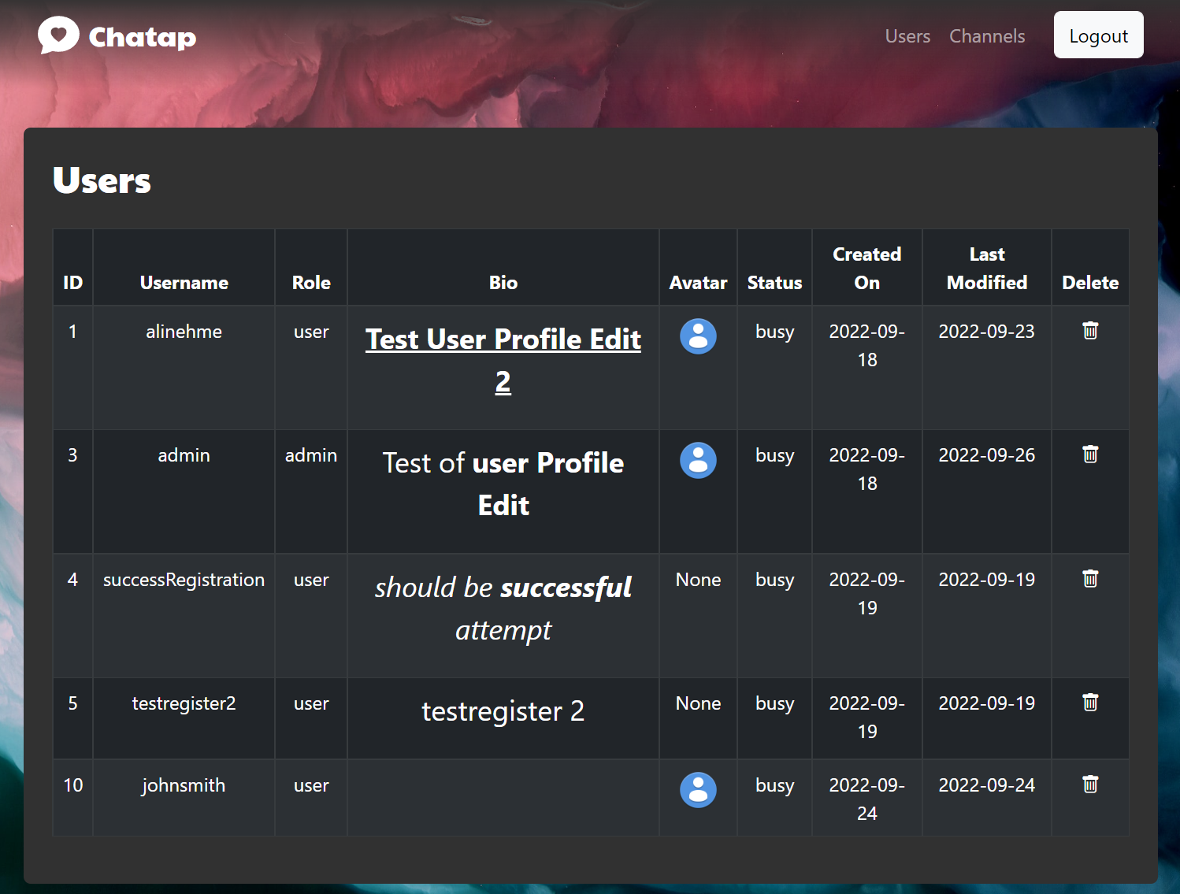
Roles
Users
Admin

Slide 7
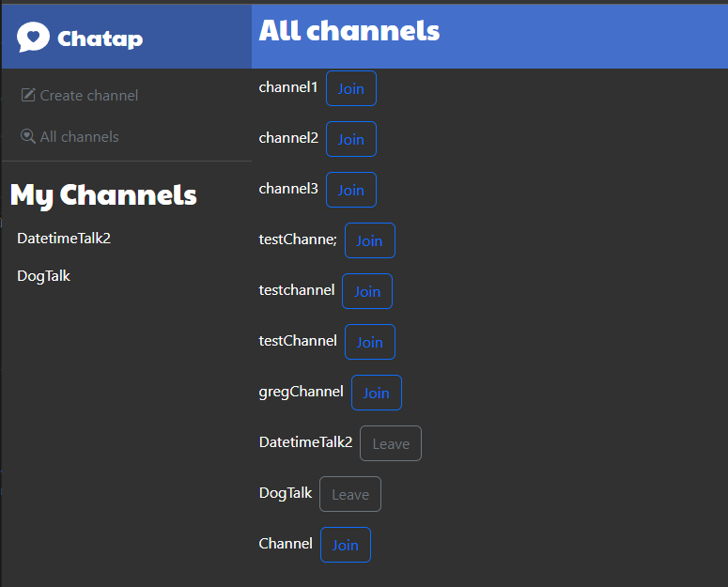
Solution Overview: Channels
Users interact with each other in private channels
Users can create a new channel and become owner of that channel
Users can view existing channels and join them

Slide 8


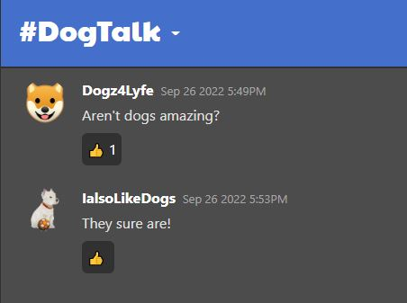
Solution Overview: Messaging
Users post messages in real-time to all users in the channel
An indicator shows when another user is typing
Users can react to each other's messages by "liking" them
Users can delete their own messages

Slide 9
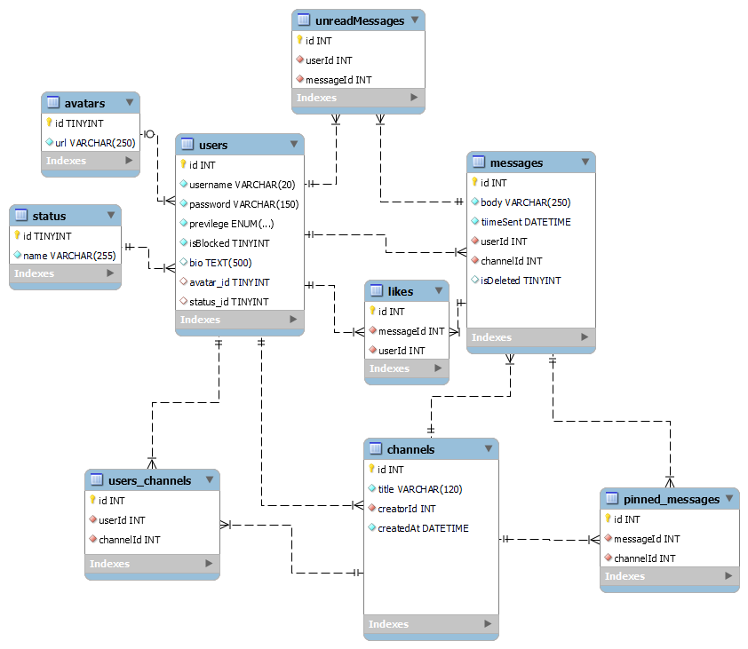
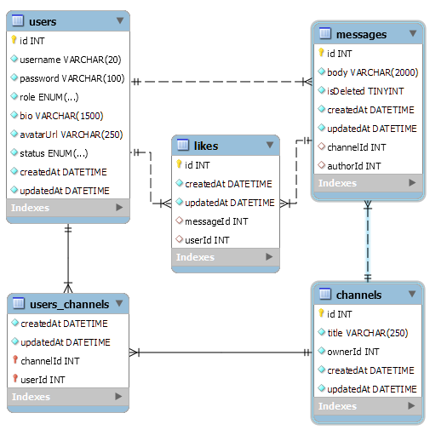
Challenges and Solutions: (D)evolving Database
Original Design
Final Design

Slide 10

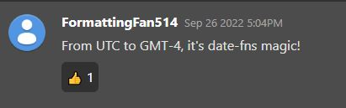
Challenges and Solutions: Date Formats
Sequelize automatically creates createdAt and updatedAt columns
Retrieved from DB in UTC format string ex: 2022-09-26T21:04:15Z
JS date utility library
2022-09-26T21:04:15Z becomes...

Slide 11
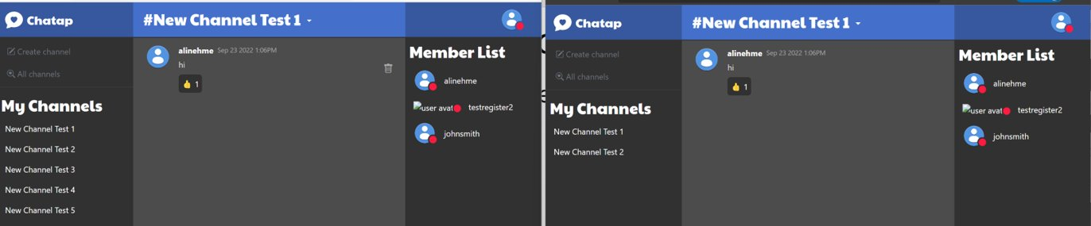
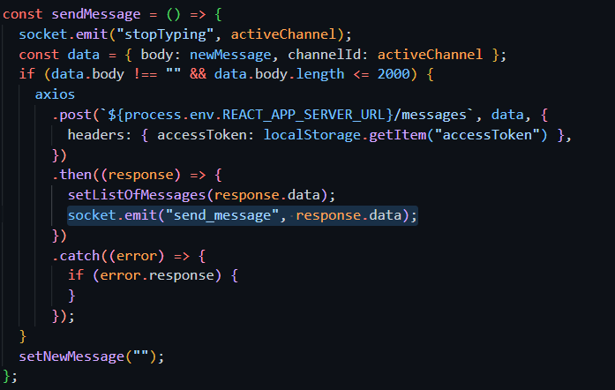
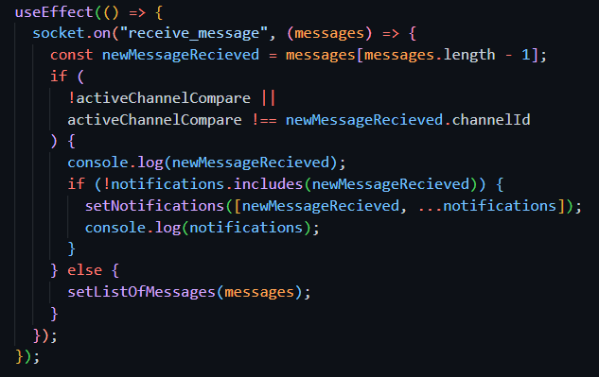
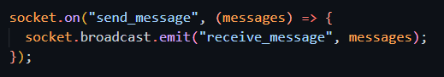
Challenges and Solutions: Socket.IO
Real-time delivery of information to other users in the channels​
Independent from, but works with, React/Node.js​
Sender
Receiver
backend

Slide 12
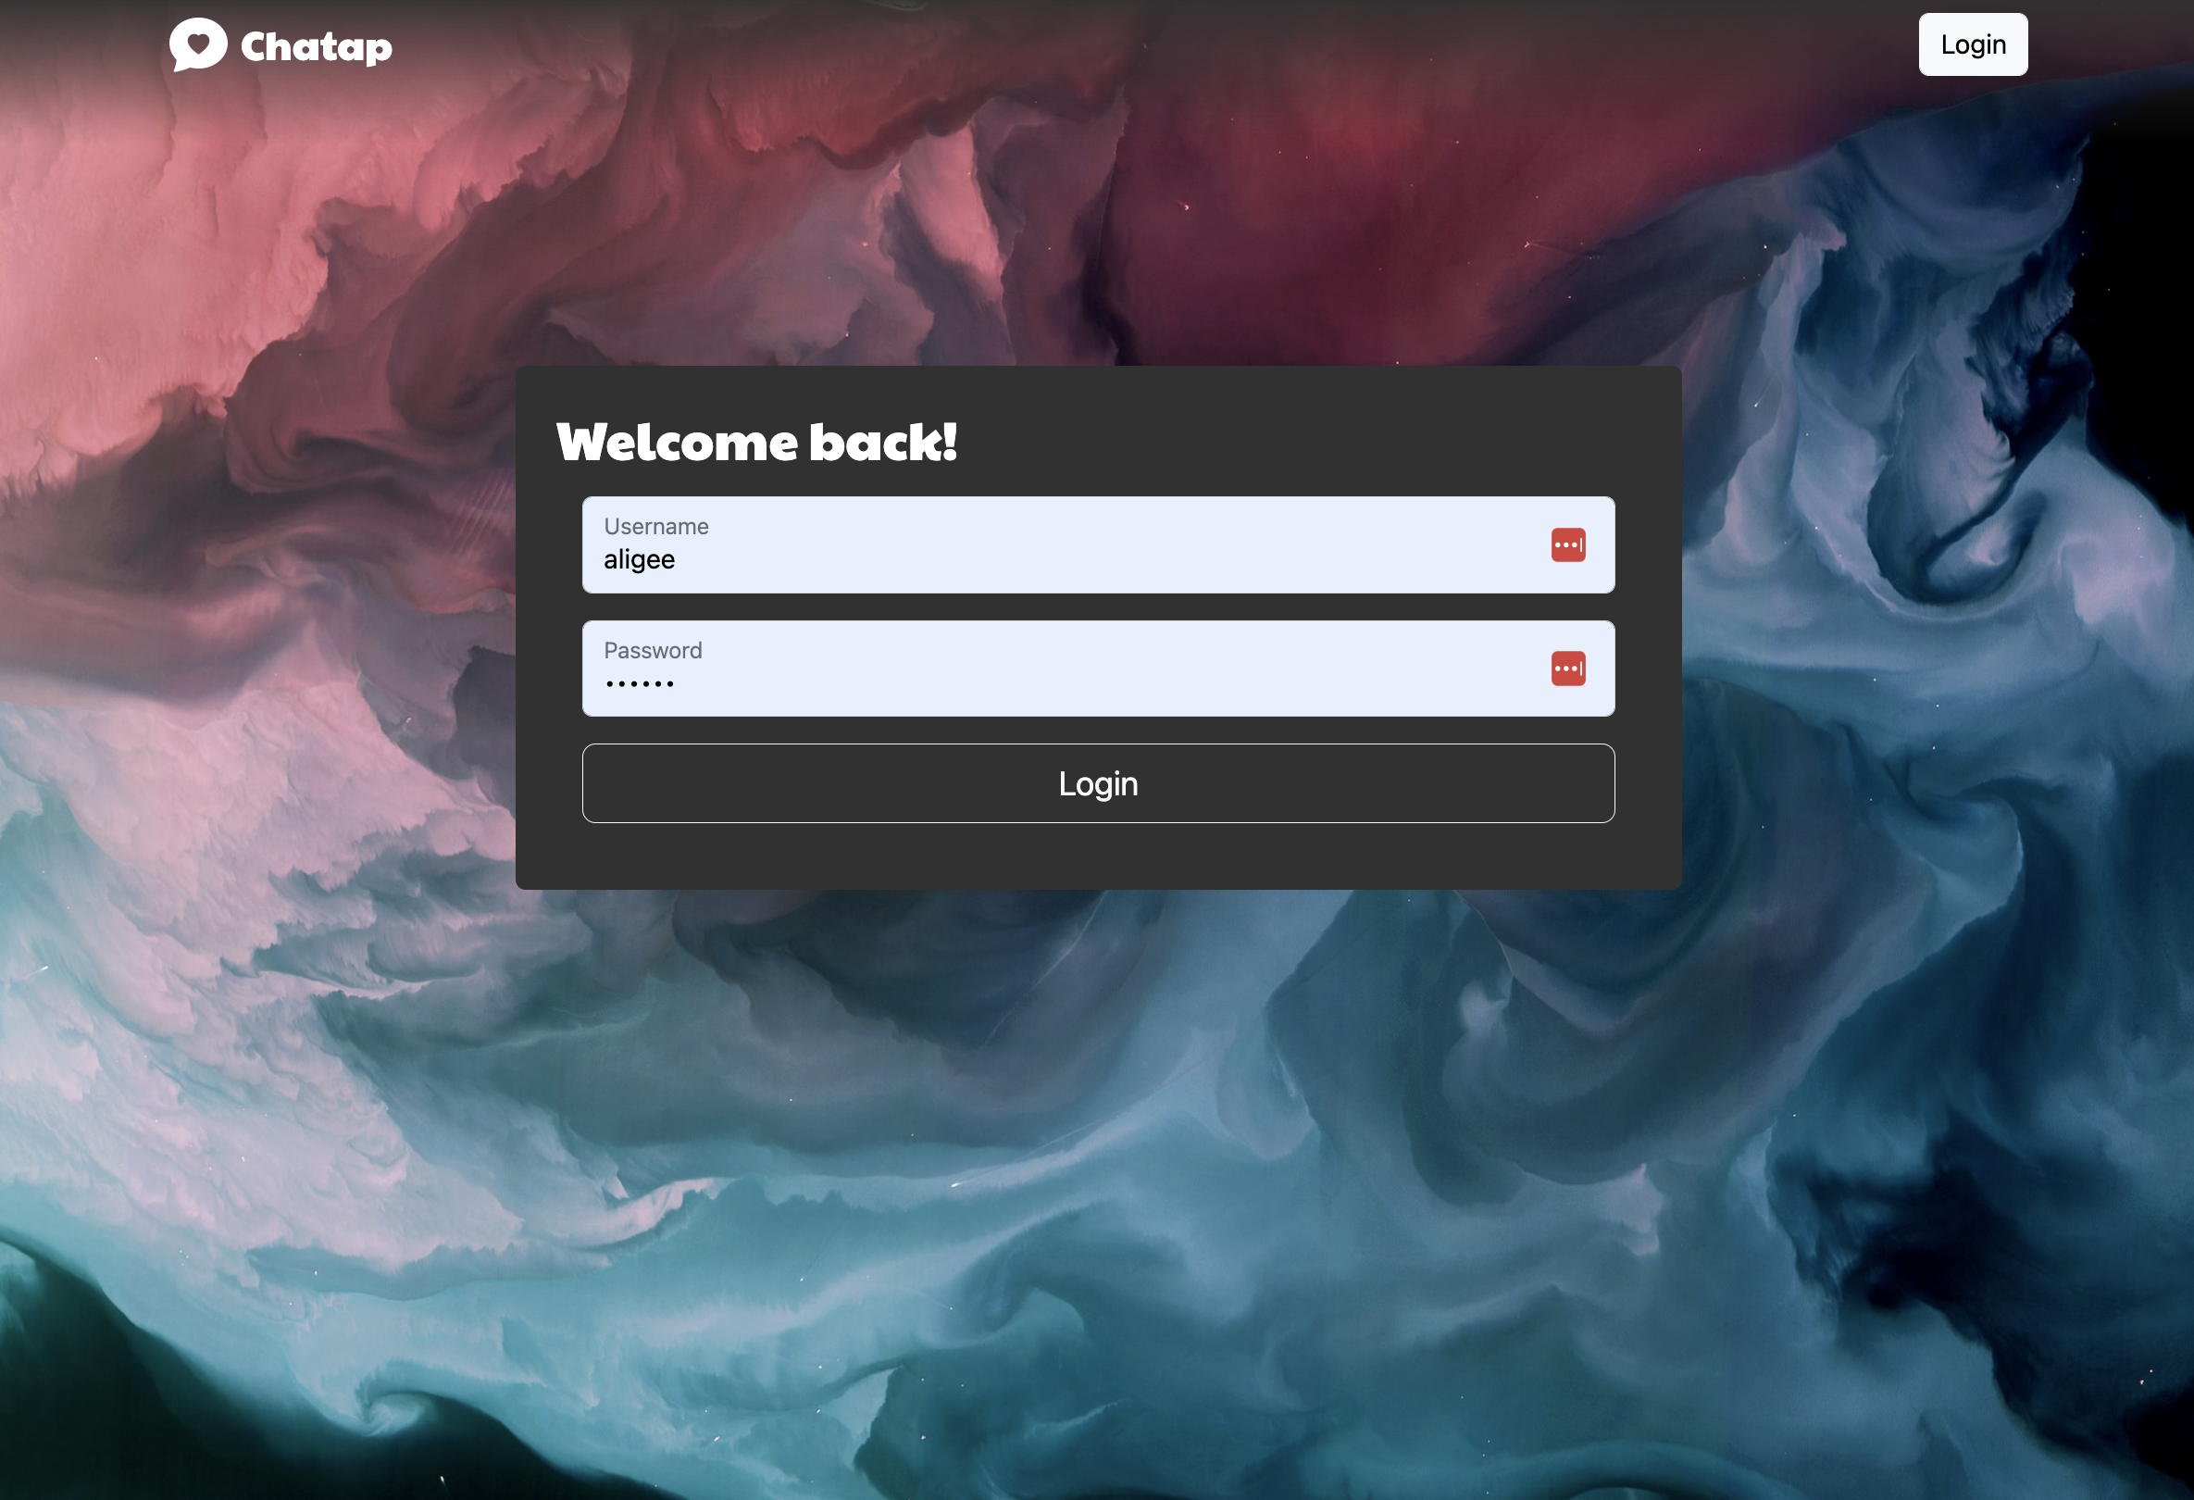
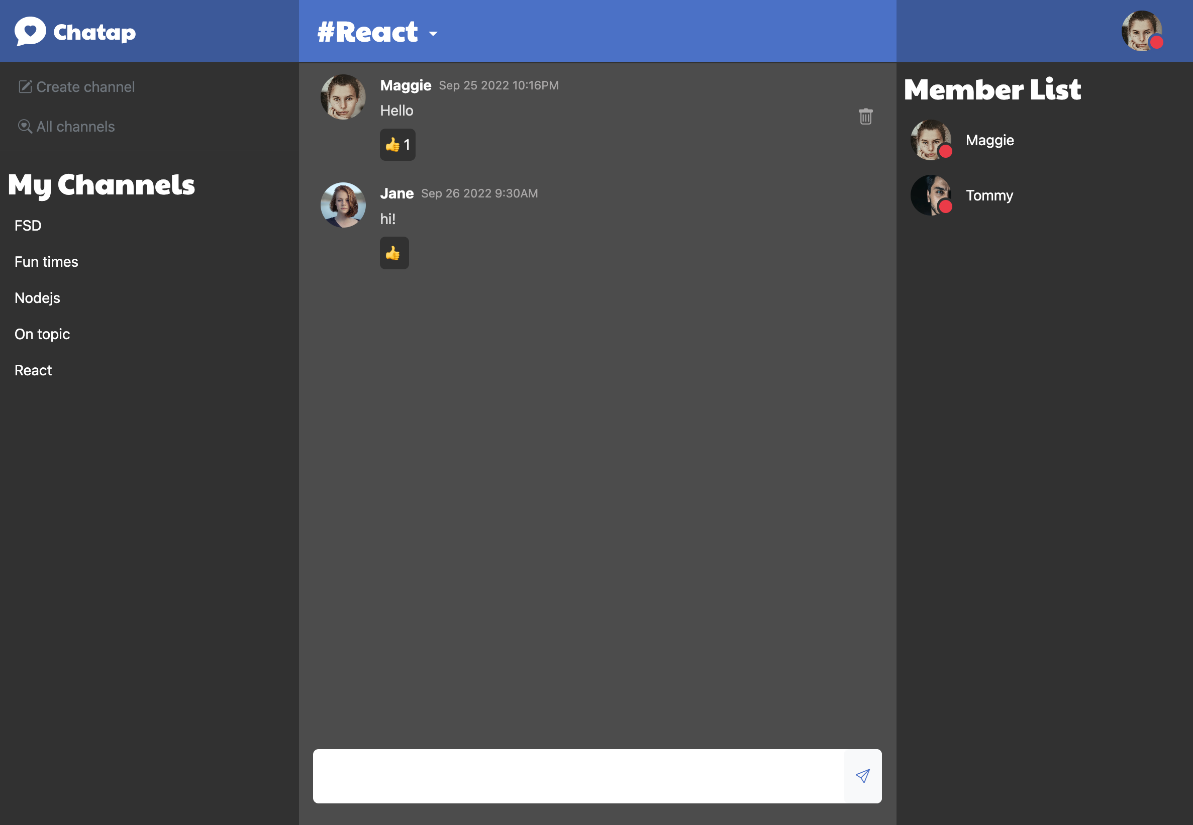
Teaching: Wrapper components
Use cases:
Many components that share the same layout?
Part of the page UI stays the same while other components change? (ex. Grid system)
Frequently used UI elements with unknown children?
Notes:
Wrapper components. What are they? The name says it all!
They’re components that wrap around their children allowing you to create layout templates and reusable UI
Explain examples
When you create your wrapper, you don’t need to define who its children will be

Slide 13
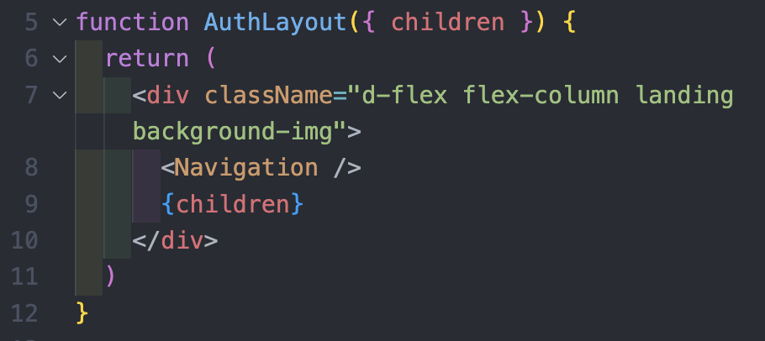
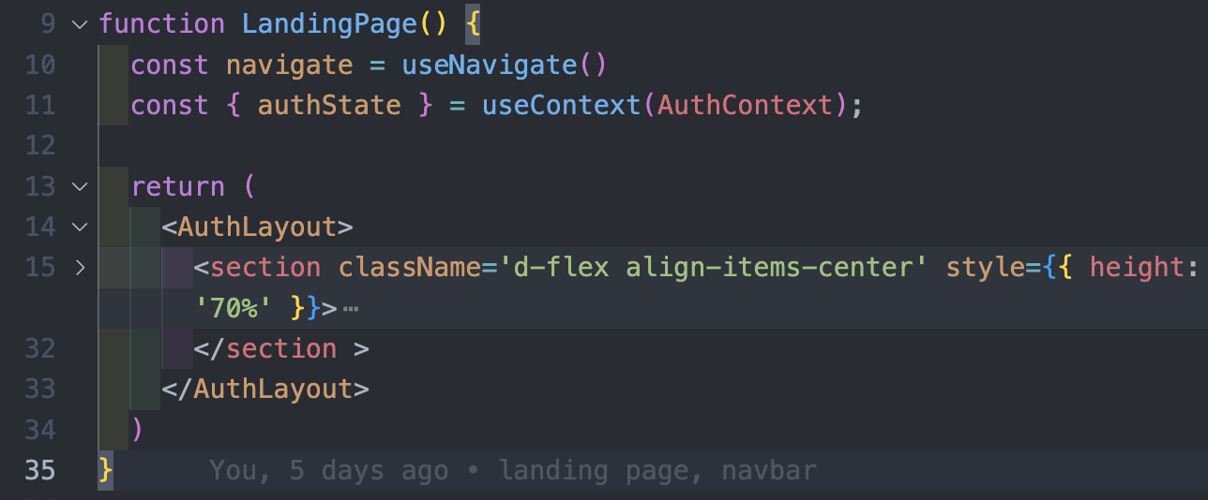
Teaching: Wrapper components
Step 1: Create your wrapper component
Step 2: Insert {children} - don’t need to know them in advance
Step 3: Wrap children in the wrapper (don’t forget to import!)
Add as many children to the wrapper as you like!
Notes:
I like to organize my components in Folders including the js file and css file for that component
Add any components that will be part of the layout (navbar)
Wrap any children
children props – destructuring the props object
More lines of code in landing page, hidden to be clear
Children have access to styles, functions, and props of the wrapper
How React Bootstrap is build
Bootstrap depends on jQuery, but jQuery is not ideal for React, as it uses direct DOM manipulation while React uses a virtual DOM. React Bootstrap essentially replaces the Bootstrap JavaScript, so each component has been rebuilt to integrate beautifully with React. This gets rid of the need for jQuery.
https://dev.to/taiwobello/how-to-create-a-wrapper-component-in-react-29p
Ali will show us a way to sanitize our code

Slide 14
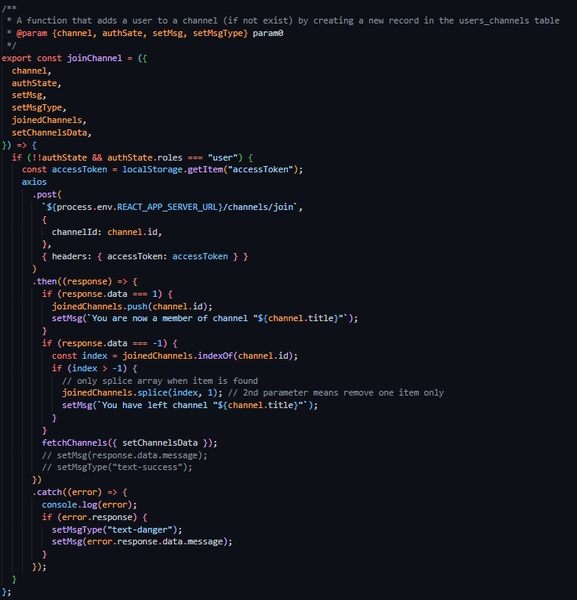
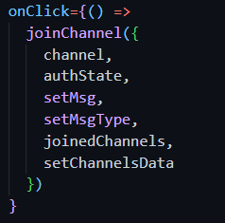
Utils File + Passing functions
Code Reuse: DRY
A Utilities file to hold reusable functions
Example from the Home page
~40 lines of code
2 lines of code
Notes:
- Many functions were being called in multiple components multiple times and components and pages quickly became cluttered.
- To deal with the issue we created the Utils.js file to hold commonly used functions
- we could then import the Utils file and specify which functions we needed for that particular page or component
- and example of a function that saw a lot of reuse is getChannelMessages, a function to get all the messages for the active channel

Slide 15
Deployment
Change routes in frontend
Upload project onto EC2
Run
Prepare backend for build
Create AWS EC2 instance
Install MySQL2 and necessary tools on EC2
Install modules
build project

Slide 16
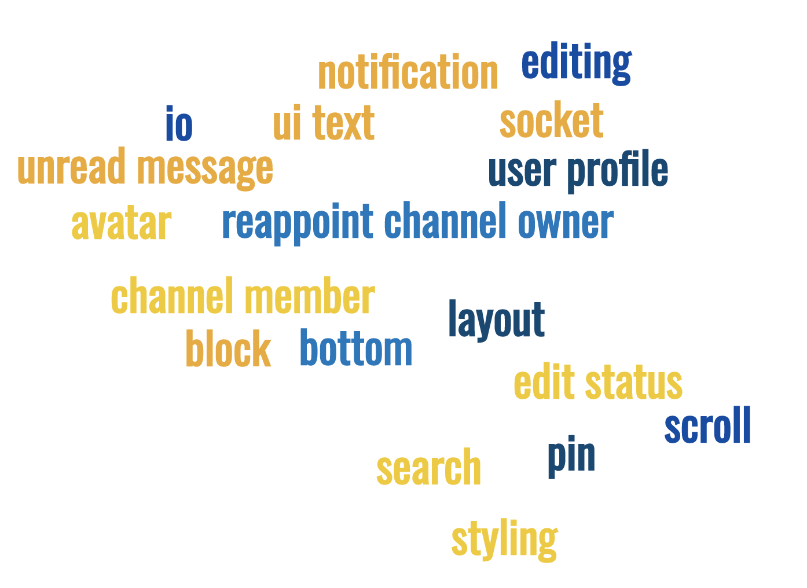
Future Work
…Oh, the features we would implement if we had an extra week!
Notes:
User editing their own messages
User searching messages/channels
Ability to "pin" messages/channels
Users viewing each other's profile
Channel admin features: blocking/invites
Selectable user avatars
Selectable user statuses
Use Socket.IO to update other features beside messaging ( like likes, live Channel title changes)
Learn and best practices
While we’re happy this week is over, part of us wishes we had an extra week to implement all the features we had in mind.
Here is a word map depicting the jumble in our brains

Slide 17
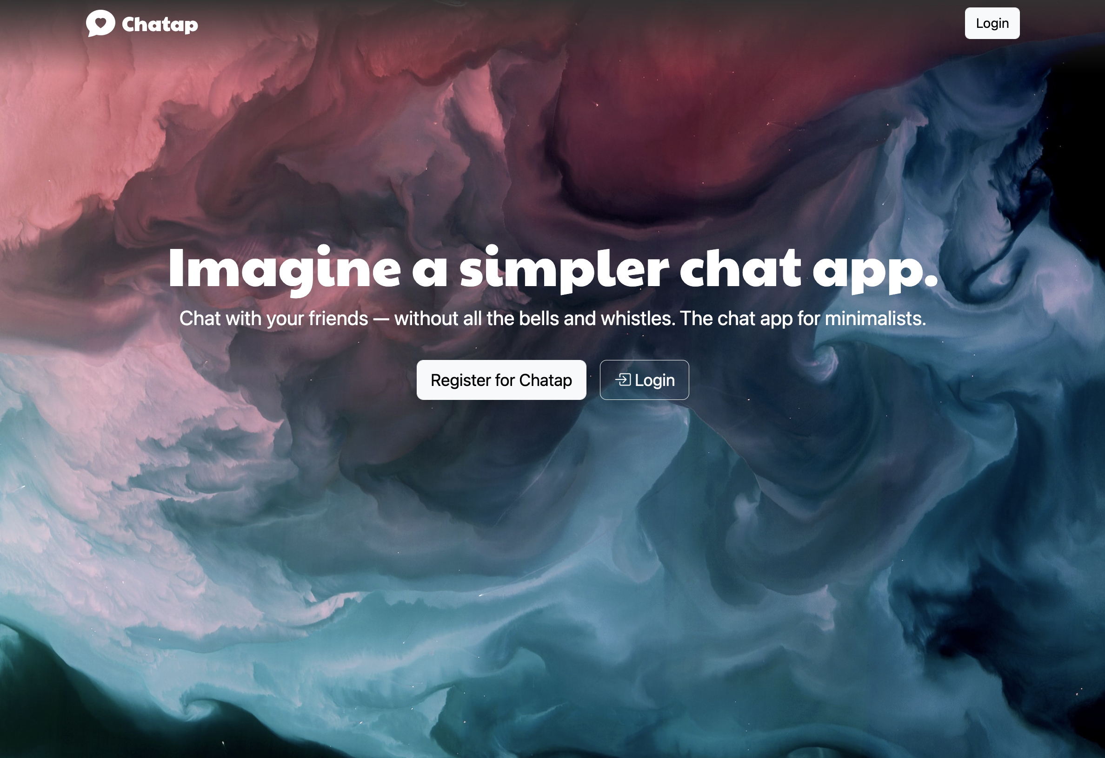
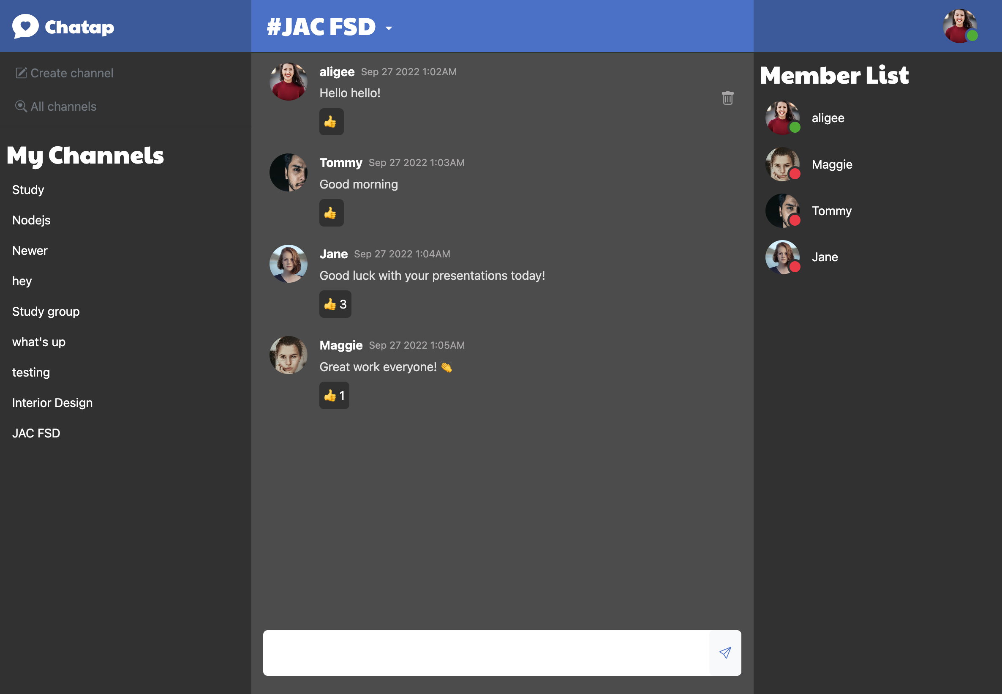
Summary
Notes:
We set out to make a real time chat, drawing inspiration from the look and feel of apps like Discord and Slack, that allow users to chat in channels based around topics.
We managed – almost in the nick of time – to host the app with AWS
Protected routes, JWT validation to add security
admin & user roles
learning new techniques along the way
Likes system
Simplified solution to a complex problem

Slide 18
Chatap
Github: github.com/nehmea/2022-WDII-chatApp
Trello: trello.com/b/lJYiJrCL/chat-app
Hosted site:
http://ec2-18-220-245-147.us-east-2.compute.amazonaws.com:3001/
Please note that the EC2 instance running the link is shut off because it's not a free Tier
🎉

